Slide 1
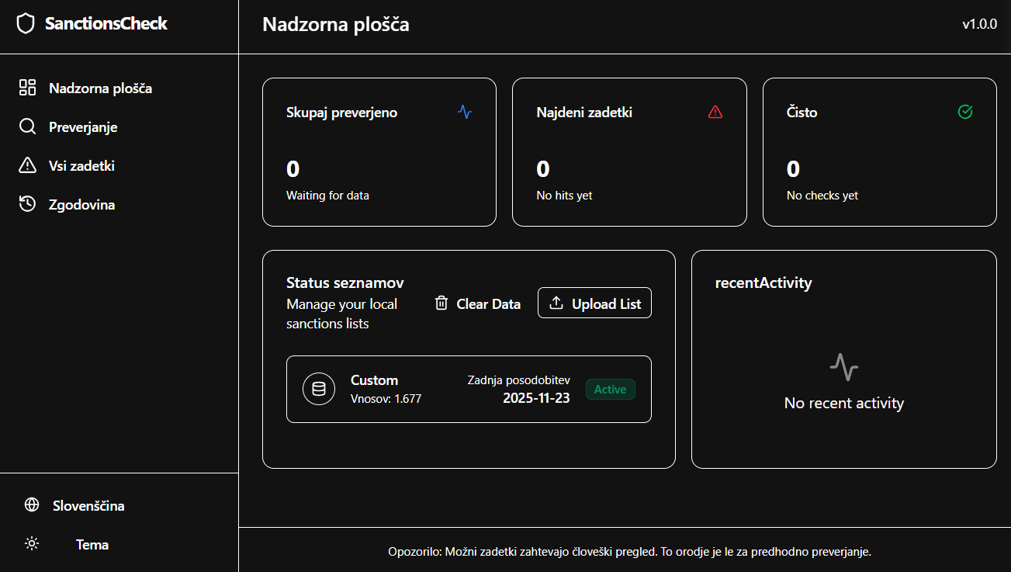

Slide 2
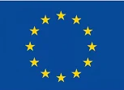


EU sanctions list
UK sanctions list
US sanctions list

